Slide 1


Network Topology Bus Topology & Collision Handling
Abraham Silberschats, Peter Baer Galvin, Gerg Gagne, Operating System Concepts, 9th Edition, Wiley

Slide 2
Collision in Networking
Define Collision in Networking
A collision happens when two or more computers send data at the same time on the same network cable. Because the data mixes together, the message becomes corrupted and must be sent again.
Why Collisions Occur in Bus Topology
In Bus topology, all devices use one main cable (backbone) to send data.
So:
Many computers share the same cable
If two devices send data at the same time
Their signals collide
Example: If Computer A and Computer B send messages at the same time on the same cable → collision occurs.
ecurity
Proce Process Management, Memory Management, Storage Management, Protection and Security vss Management, Memory Management, Storage Management, Protection and Security Process Management, Memory Management, Storage Management, Protection and Security

Slide 3
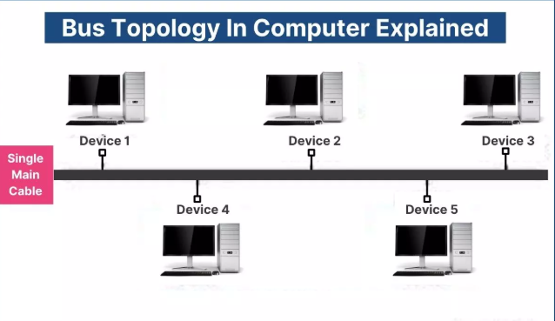
Bus Topology
Definition
All devices share a single main cable (backbone).
Real-life Example
A cable TV line runs along the street, and every house connects to the same main wire. If the main wire is cut, everyone loses the signal
Advantages
Cheap
Simple for small networks
Uses less cable
Disadvantages
If main cable breaks → network fails
Limited number of devices can be connected
Low security
Topology
Bus Topology

Slide 4
How CSMA/CD Work
CSMA/CD = Carrier Sense Multiple Access / Collision Detection
It is a method used to control collisions in bus networks.
Steps:
Carrier Sense A computer first checks the cable to see if someone is sending data.
If the cable is free The computer sends the data.
Collision Detection If two computers send data at the same time, the system detects the collision.
Stop Transmission Both computers stop sending data.
Random Wait Time Each computer waits for a random time.
Resend Data After waiting, they send the data again

Slide 5
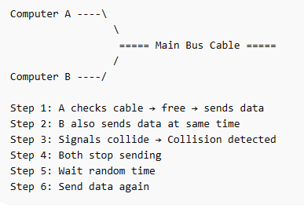
Working Mechanism of CSMA/CD
.
CSMA/CD is a network protocol used in bus topology where devices first check the cable before sending data and resend the data if a collision occurs.

Slide 6
CSMA/CD – Features and Limitations
Features
Collision detection: Detects when two devices send data at the same time.
Carrier sensing: Device checks the cable before sending data.
Retransmission: If a collision occurs, data is sent again after waiting.
Efficient for small networks: Works well when few devices are connected.
Simple method: Easy to implement in bus or early Ethernet networks.
Limitations
Performance decreases with many users: More devices → more collisions.
Network becomes slow: Frequent collisions reduce speed.
Works only in shared networks: Not used in modern switched Ethernet.
Limited distance: Cable length affects collision detection.
Less efficient for large networks

